Slide 1
Use case Diagram super market for Checkout system

Slide 2
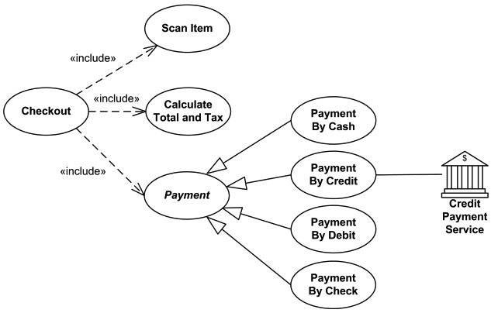

Use case diagram for Super market checkout system
Clerk/administrator
Customer

Slide 3
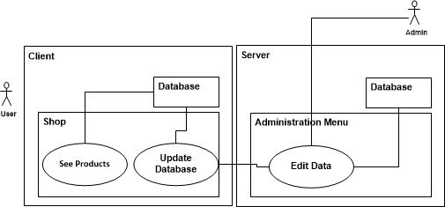
Products Database

Slide 4
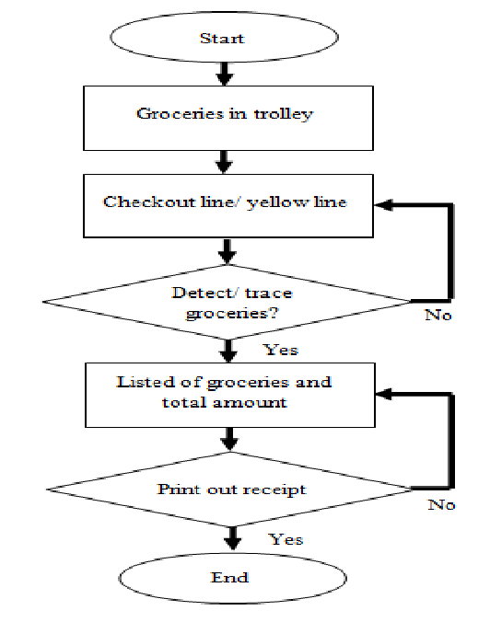
Flow chart

Slide 5


